Slide 1
Data Management CT051-3-M
Topic 2 – Organizational Data Preparation

Slide 2
Topic and Structure of the Lesson
At the end of the lecture you should be able to
Importance of Data Management
List and define various sources of data
Explain the fundamental differences between databases, data warehouses and datasets
Explain some of the ethical dilemmas associated with data mining and outline possible solutions

Slide 3
Data Realities…

Slide 4













Images collected by DataOne.org
Notes:
The world today is filled with science news, from climate change to hurricanes – and it all affects the people inhabiting the earth.

Slide 5
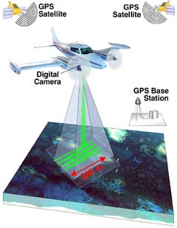
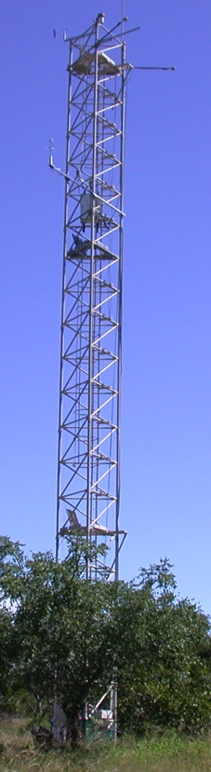


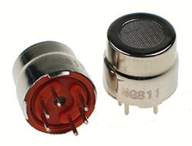


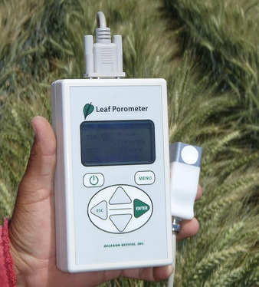
Data deluge
Data is collected from sensors, sensor networks, remote sensing, observations, and more - - this calls for increased attention to data management and stewardship
Photo courtesy of http://modis.gsfc.nasa.gov/
Photo courtesy of
http://www.futurlec.com
CC image by tajai on Flickr
Photo courtesy of www.carboafrica.net
CC image by CIMMYT on Flickr
Image collected by Viv Hutchinson
Notes:
Data is being generated in massive quantities daily. Improvements in technology enable higher precision and coverage in data acquisition and makes higher capacity systems store and migrate more data –increasing the importance of managing, integrating, and re-using data.

Slide 6
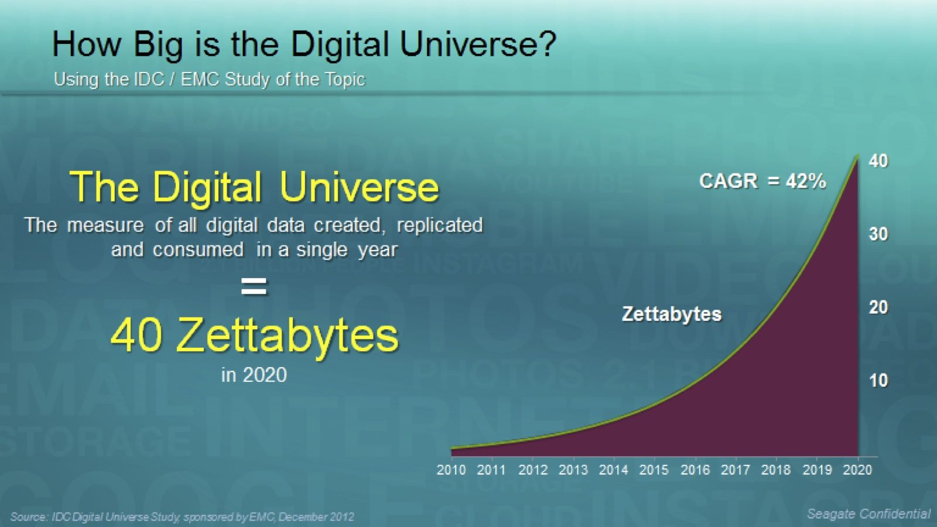
The World of Data Around Us)
Petabytes Worldwide
Notes:
6
The amount of available storage is not keeping up with the amount of data flooding in daily. How do we decide what data we keep?

Slide 7
Data Storage
Database
Data Warehouse
Data Mart
Datasets

Slide 8
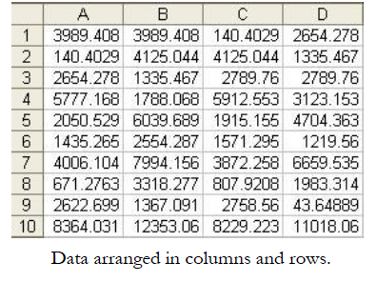
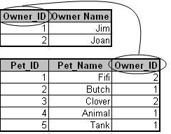
Data Storage: Databases
Tuples or Records or Rows
Fields, Variables or Attributes

Slide 9
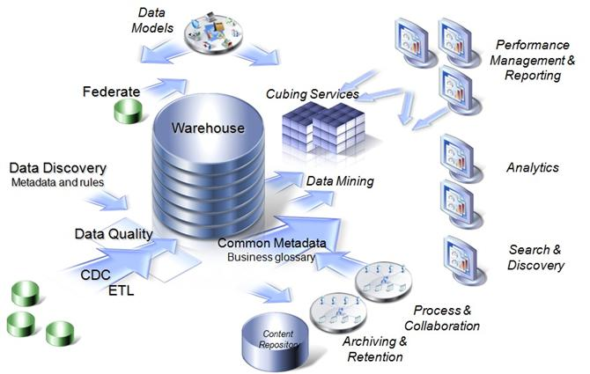
Data Storage: Data Warehouse

Slide 10
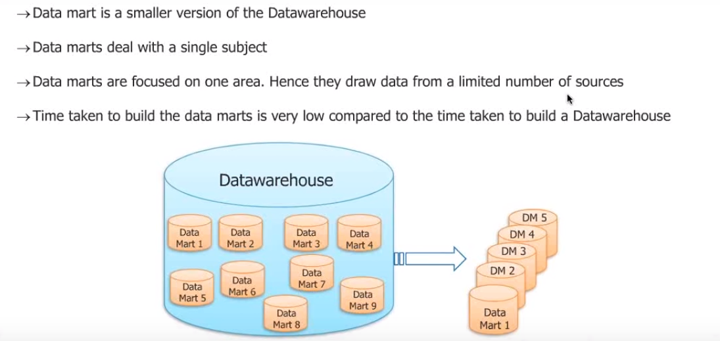
Data Storage: Data Mart

Slide 11
Data Storage: Dataset

Slide 12

Why Mine Data? Commercial Viewpoint
Lots of data is being collected and warehoused
Web data, e-commerce
purchases at department/ grocery stores
Bank/Credit Card transactions
Computers have become cheaper and more powerful
Competitive Pressure is Strong
Provide better, customized services for an edge (e.g. in Customer Relationship Management)

Slide 13
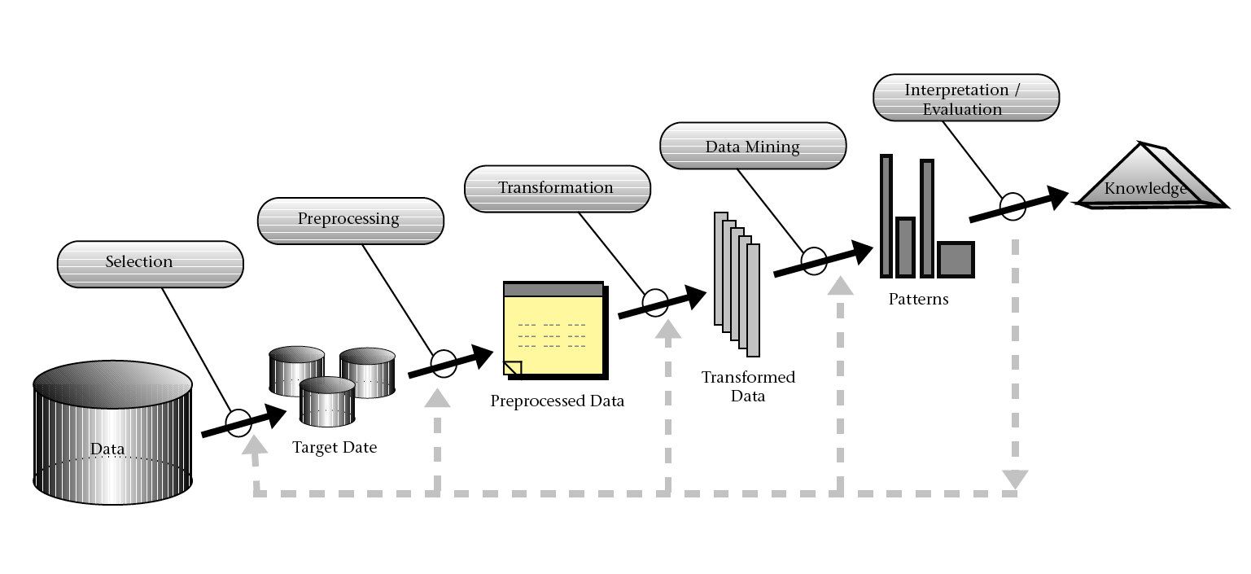
Knowledge Discovery in Database (KDD Process)

Slide 14
What is (NOT) Data Mining?
What is not Data Mining?
Look up phone number in phone directory
Query a Web search engine for information about “Amazon”
What is Data Mining?
Certain names are more prevalent in certain US locations (O’Brien, O’Rurke, O’Reilly… in Boston area)
Group together similar documents returned by search engine according to their context (e.g. Amazon rainforest, Amazon.com,)

Slide 15
Origins of Data Mining
Draws ideas from machine learning/AI, pattern recognition, statistics, and database systems
Traditional Techniques may be unsuitable due to
Enormity of data
High dimensionality of data
Heterogeneous, distributed nature of data
Statistics/ AI
Machine Learning/
Pattern Recognition
Data Mining
Database systems

Slide 16
Data Mining Methods – Task Categorization
Supervised vs. Unsupervised
Unsupervised Methods (also called Descriptive): Try to find meaningful patterns in the data.
Clustering: group similar data into clusters
Market Segmentation, Document Clustering
Association Rule Discovery: find human interpretable patterns (associations)
Product Recommendations, Store Shelf Management
Sequential Pattern Discovery: describe the sequential dependencies among different events
Buying Patterns, Gene Sequencing
Unsupervised anomaly detection to detect anomalies in unlabeled data under the assumption that the majority of the instances are normal
Fraud Detection, Network Intrusion Detection
Supervised
Unsupervised
Clustering
Association Rule Discovery
Sequential Pattern Discovery
Anomaly Detection

Slide 17
Data Mining Methods – Task Categorization
Supervised vs. Unsupervised
Supervised Methods (also called Predictive): Predict an unknown value(s) of a variable(s) from the values of some attributes
Classification: predict the type/class of new cases
Spam Filtering, Handwriting Character Recognition, Patient Diagnosis
Regression: predict a numerical value of new cases
Blood Pressure, Sales Amounts
Supervised Anomaly Detection: identify items, events or observations deviating from expected patterns using data labeled as "normal" and "abnormal" (involves training a classifier)
Supervised
Classification
Unsupervised
Clustering
Regression
Anomaly Detection
Association Rule Discovery
Sequential Pattern Discovery
Anomaly Detection
It is common to combine different methods such as clustering and classification (Hybrid methods)

Slide 18
Question & Answer Session
Q & A

